Slide 1

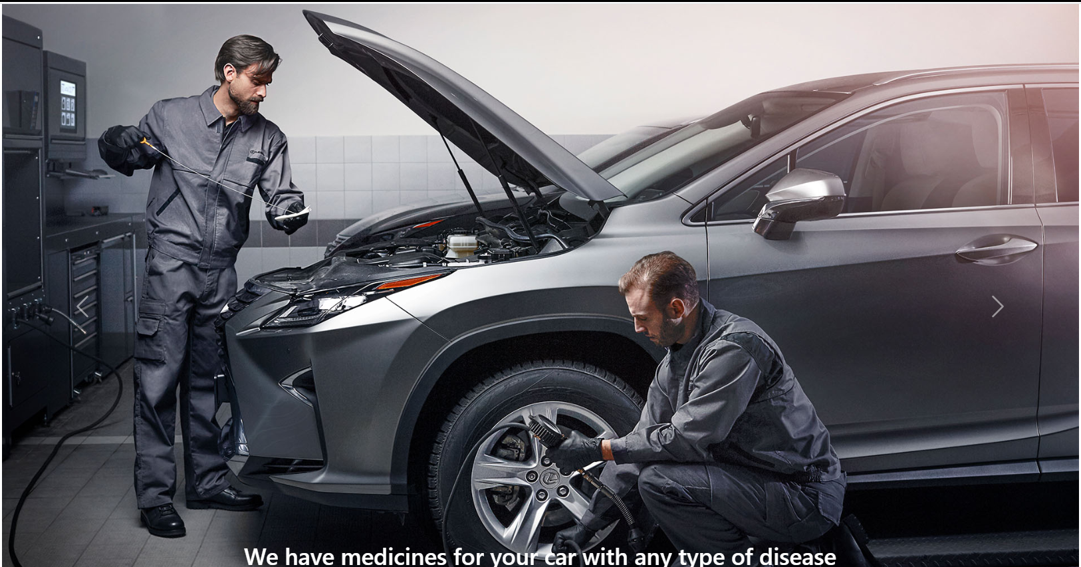
Online Vehicle Service Station
KNOW-IT, C-DAC ACTS (ATC), Pune
Project Group : 10
210943020048 Rutuja Snajay Malvadkar
210943020060 Omkar Dnyaneshwar Badhe
210943020084 Saurabh Pushparaj Jagtap
210943020113 Harshal Ramesh Gunjal
Guided By Prof. Bakul Joshi

Slide 2
Agenda
Project introduction
Project architecture
Technology platform used for project
User roles and responsibilities
Division of work within team
Details of my contribution
Known issues if any
Conclusion
Future extensions if any

Slide 3
Project Introduction
Purpose of the project
The main objective of this project is to provide a platform for the garage owners to keep track of service requests from the customers. This System will also help the customer to find out the best service centers based on reviews of customers. Customer will get specific time to drop the vehicle at the service centers which will avoid wastage of time. Mechanics working in the service center even can maintain record about their task more efficiently.
2. Need
Currently vehicle servicing management has become a tedious job. It is difficult for small scale businesses to maintain data for longer time as they are using paper based system. Customers also need to find nearest garage which provide authentic service. Thus, online Vehicle service station is proposed to assist people and fulfill their requirements easily.

Slide 4
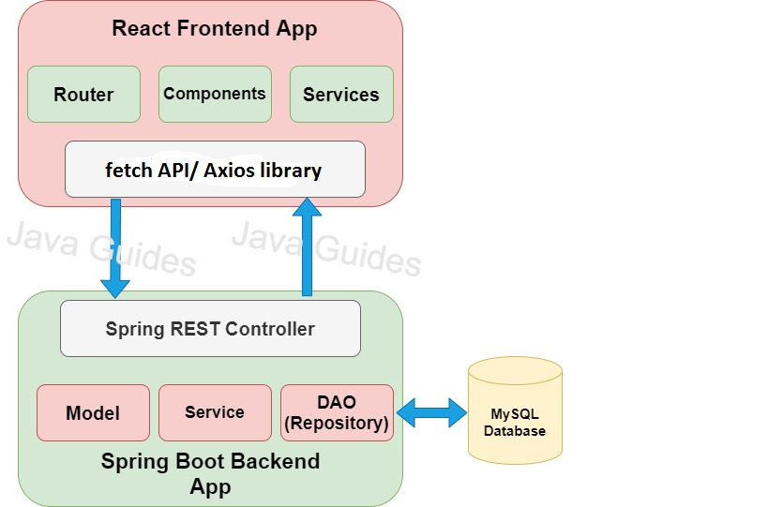
Project Architecture

Slide 5
Technology platform used for project
Technologies used :
Front end : HTML, CSS, Javascript, React JS
Middle tier : Springboot, Hibernate
Database : MySQL
2. Reason for selecting specific technologies
React JS :
The React basically allows developers to utilize individual parts of their application on both client-side and the server-side, which ultimately boosts the speed of the development process.
Compared to other frontend frameworks, the React code is easier to maintain and is flexible due to its modular structure.
The core of the framework offers a virtual DOM program and server-side rendering, which makes complex apps run extremely fast.

Slide 6
Spring boot
Its main purpose is RAD(Rapid Application Development) i.e. reducing development time as much as possible.
It quickly releases the app in production environment and follows some development model ‘defaults opinionated approach’ i.e. spring boot will configure few things automatically.
Spring boot comes with embedded tomcat server so there is no any context root and hence application is deployed as self deployable unit.
MySQL
MySQL is globally renowned for being the most secure and reliable database management system used in popular web applications like WordPress, Drupal, Joomla, Facebook and Twitter. The data security and support for transactional processing that accompany the recent version of MySQL, can greatly benefit any business especially if it is an eCommerce business that involves frequent money transfers.
MySQL offers unmatched scalability to facilitate the management of deeply embedded apps using a smaller footprint even in massive warehouses that stack terabytes of data. On-demand flexibility is the star feature of MySQL. This open source solution allows complete customization to eCommerce businesses with unique database server requirements.

Slide 7
User roles and responsibilities
User roles :
Admin
Owner
Employee
Customer
Responsibilities for each user :
Admin : -Add Owners
-View all the feedbacks provided by customers and generate report
Owner : -Create Employee Accounts
-Confirm request of customer
-Manage and update the stock.
-Assign service requests to employee.
-Add service details(category ,service ,price ,description)

Slide 8
Employee: - Create invoice, update service status
- Manage stock
- Generate Invoice
Customer: - Book Appointment with nearby garages
- Give Feedback
3. Use case for each role
Admin : Login ,Update Account ,Add Owner , Enable/Disable Accounts , Generate
Reports.
Owner : Login , Upload Information about Service , Confirm Request of Customer, Create Staff Account , Manage Stock , View Feedbacks
Employee: Login , Update Password , View Service Requests , Update Service Status , Update Stock Information , Generate Invoice
Customer: Register , Login, Search Nearby Garages , Book Appointment , View Invoice , Give Feedback

Slide 9
Details of my contribution
We have developed by contributing equally a web application in which we have worked on both frontend and backend.
First of all we completed documentation part by making BRS and SRS document, ER diagram, zero level DFD and page navigation diagram.
After completing documentation we moved on for creating database and then further worked on server side and simultaneously on front end for registration and login purpose.
Further we worked on main use cases such as – book/view appointment , add/view service details , add/view stock ,add/view city and area, generate/view feedback.

Slide 10
Future extensions
Email/Text message Notification to customer about his request booking confirmation, status, and invoice of services provided
Online payment modes.
Benefits of these implementations :
By these implementations customer will stay updated about his requests time to time and also cashless transactions will be beneficial for customer as well as garage owners.

Slide 11
Conclusion
Online Vehicle Service Station provides better platform for customer to get their vehicle serviced by searching nearby service station. Customer can also watch the different services provided by different garage owners and price/rates for each service. He is also able to view the feedbacks given by other customers to nearby service centers and then can decide best suitable service station for him.

